Slide 1
Finance Sector Capstone Project Business Analytics Stream PGPDS, IIIT-B January 2023
Stock Price Analysis and Forecasting
Gayathri Sakthirajan
Sufi Ali
Vibhuti Singh
Sudhir Choudary

Slide 2
Objective
Objectives:
Explore the stock prices based on trend, correlation between the stocks
Evaluate the stocks based on Capital Asset Pricing Metrics
Suggest investment strategy for the client to achieve her financial goal of getting good but stable returns to fund her NGO
Data Available:
Data of 12 stocks in the US market and the index SP500
The stocks are from Aviation, Healthcare, Finance and Technology industries.
Three stocks from each of these industries

Slide 3
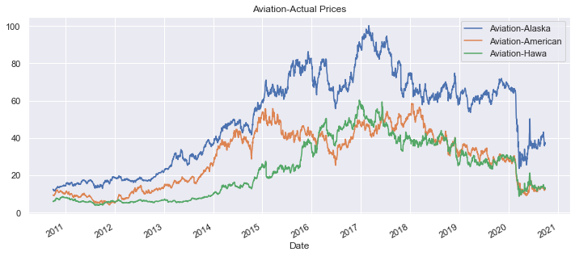
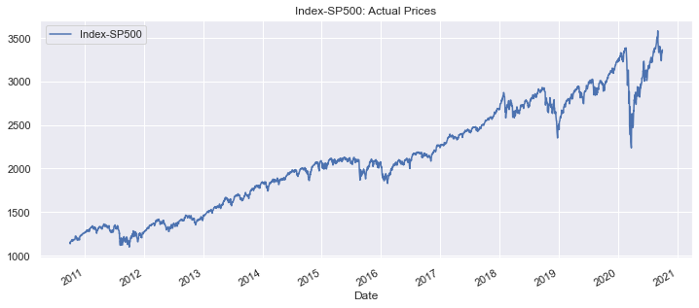
Price Trend-Actual Prices
Aviation sector:
All the three stocks in the aviation sector had an increasing trend until 2017-18.
From 2017-18 there are ups and downs until March 2020
In March 2020, the steep fall in prices could be noticed.
This may be attributed to the Covid outbreak by which the top and bottom lines of all the companies in aviation industry invariably were hit badly.
The fall is steeper for Alaska Airlines.
After March, there exists a small but positive trend in the prices of all the stocks.
Significant variation in price level
The stocks behave in sink with the index SP500 from March 2020 onwards.

Slide 4
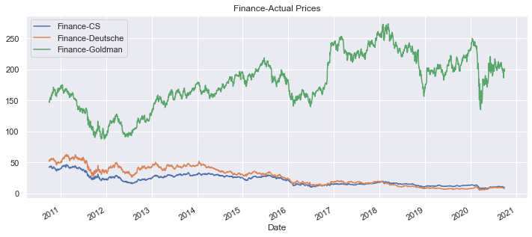
Price Trend-Actual Prices
Finance sector:
Significant variation in price level between Goldman Sachs and the other two stocks.
Credit Suisse and Deutsche Bank show a clear negative trend while the Goldman is bumpy but overall positive.
In March 2020, the steep fall in prices could be noticed.
This may be attributed to the Covid outbreak by which the top and bottom lines of all the companies in aviation industry invariably were hit badly.
After March, the recovery of Goldman is in line with the index but hasn’t yet reached the pre-covid levels.

Slide 5
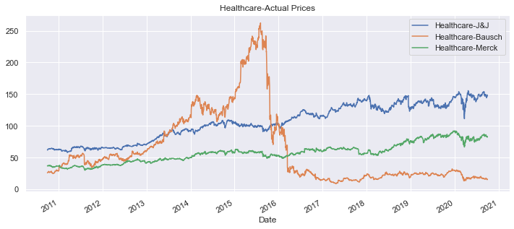
Price Trend-Actual Prices
Healthcare sector:
Bausch started low, reached its peak in mid 2015 followed by a very steep fall through 2016; The charges of inappropriate accounting led Bausch to suffer this fall. Bausch also has a huge debt burden, which compounded the problem.
Jhonson & Jhonson and Merck grow steadily.
J&J is found to be one of the companies that recovered swiftly after the Covid outbreak followed by Merck while Bausch is yet to recover.

Slide 6
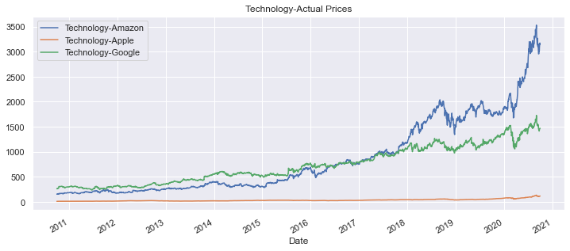
Price Trend-Actual Prices
Technology sector:
All the three stocks show a clear uptrend, Amazon being the mostly sough after.
The growth of Amazon is phenomenal while Apple is progressing steadily.
Google was at the top in the beginning of the period but from 2018 onwards the prices have fallen below Amazon.
Price levels among these stocks vary widely. Apple’s prices are the lowest and hence traded more than Google

Slide 7
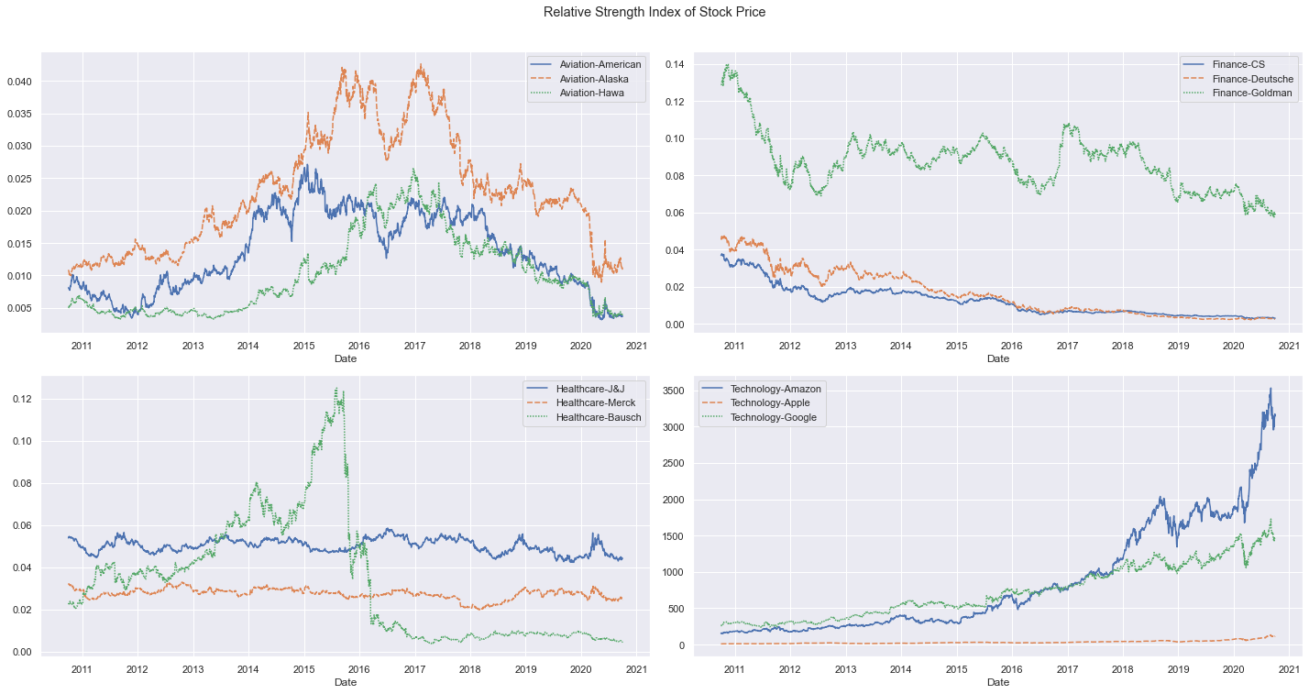
Relative Strength index of Stock prices
1. The relative strength Index also confirms the earlier findings. The only industry in uptrend is Technology; Although their price levels are highly different
2. In healthcare, J&J and Bausche move parallelly with the index.
3. Stocks in Healthcare and Finance industry show a downtrend.

Slide 8
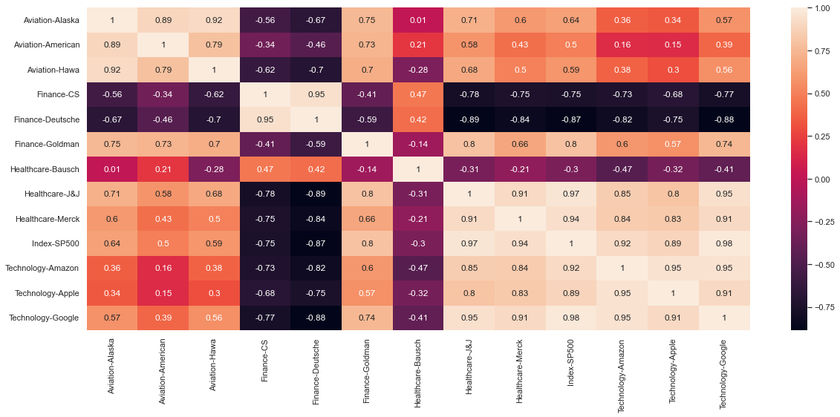
Correlation - Price
1. Stocks with Strong Positive Correlation (0.6 to 1): Apple, Amazon, Google, Goldman Sachs, J&J, Merck & Co & Alaska
2. Stocks with Weak Positive Correlation (0 to 0.6): American Airlines, Hawaiian Holdings.
3. Stocks with Negative Correlation (0 to -1): Bausch Health, Credit Suisse, Deutsche Bank.

Slide 9
Capm-Metrics used for selection of stocks
1. Annualized Return
2. Cumulative Return
3. Annualized Risk
4. Sharpe Ratio
5. Beta
6. Expected Return

Slide 10
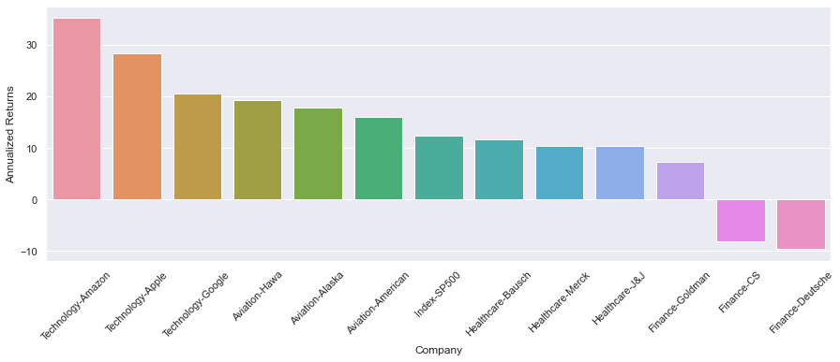
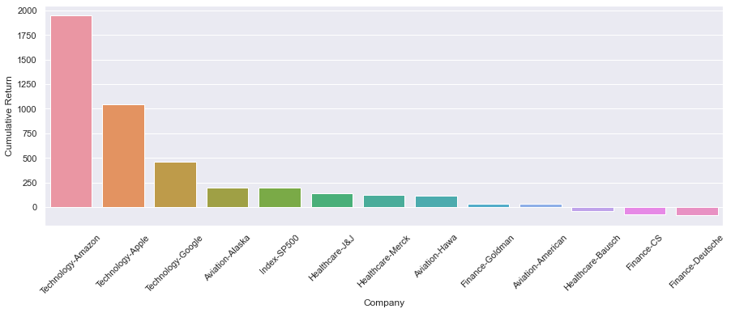















CAPM-Annualized Return
Credit Suisse and Deutsche Bank show negative annualized returns and cumulative return and hence can be dropped.
Tech stocks stand at the top giving highest annualized and cumulative returns

Slide 11
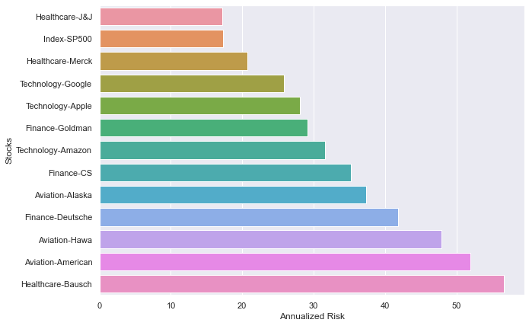
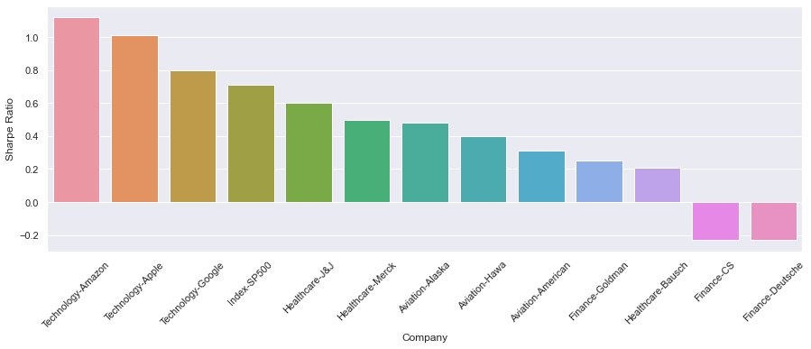













CAPM- Annualized Risk & Sharpe Ratio
Sharpe Ratio is a composite index of risk and return. Higher the sharpe ratio, the better the stock is.
Stocks with Sharpe Ratio more than that of index SP500 are Amazon, Apple and Google and others can be dropped in the final portfolio.

Slide 12
CAPM Results
S.No | Stocks | Annualized Returns | Cumulative Return | Annualized Risk | Sharpe Ratio | Beta | Expected Return
0 | Index-SP500 | 12.29 | 193.39 | 17.36 | 0.71 | 1 | 12.29
1 | Aviation-Alaska | 17.87 | 194.28 | 37.4 | 0.48 | 1.23 | 14.96
2 | Aviation-American | 16.03 | 32.29 | 51.95 | 0.31 | 1.35 | 16.37
3 | Aviation-Hawa | 19.29 | 116.28 | 47.86 | 0.4 | 1.23 | 14.99
4 | Finance-CS | -8.19 | -76.39 | 35.25 | -0.23 | 1.37 | 16.56
5 | Finance-Deutsche | -9.62 | -84.03 | 41.87 | -0.23 | 1.54 | 18.49
6 | Finance-Goldman | 7.32 | 36.07 | 29.1 | 0.25 | 1.30 | 15.77
7 | Healthcare-Bausch | 11.71 | -39.65 | 56.67 | 0.21 | 1.32 | 15.94
8 | Healthcare-J&J | 10.3 | 141.1 | 17.22 | 0.6 | 0.66 | 8.39
9 | Healthcare-Merck | 10.34 | 126.64 | 20.72 | 0.5 | 0.73 | 9.21
10 | Technology-Amazon | 35.22 | 1948.49 | 31.57 | 1.12 | 1.00 | 12.28
11 | Technology-Apple | 28.4 | 1047.77 | 28.13 | 1.01 | 1.06 | 13.02
12 | Technology-Google | 20.6 | 461.28 | 25.86 | 0.8 | 1.01 | 12.44

Slide 13
Results of analysis of recommended stocks (From 01-10-2010 to 30-09-2020)
Stocks | Annualized Returns | Annualized Risk | Stock Cumulative Return | Invested Amount | Stock Value
Amazon | 71.55 | 3.57 | 100.13 | 166667 | 333550
Apple | 70.94 | 3.85 | 91.29 | 166667 | 318817
Google | 51.11 | 3.71 | 56.2 | 166667 | 260333
Invested Fund : 500,000 USD
Investment Period :10 Years
Matured Amount : 6.2 Mil USD
Annual ROI Portfolio : 29%
Annualized Risk : 28.52%

Slide 14
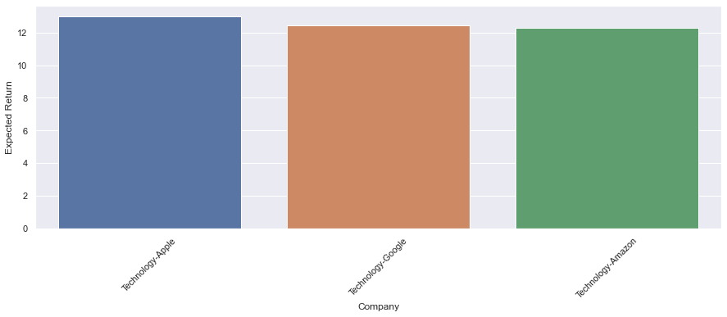

Recommended stocks – Volatility and Expected Return
Beta
Expected Return
Recommended Stocks | Beta | Expected Return
Index-SP500 (for reference only) | 1 | 12.3
Amazon | 1.00 | 12.3
Apple | 1.06 | 13.0
Google | 1.01 | 12.4
1. The volatility of all the tech stocks are not much alarming and are almost on par with the index SP500.
2. All the tech stocks give an expected return which is more than or equal to that of Index SP500
3. As the tech stocks show a balanced volatility and expected returns and hence can be selected for the portfolio.

Slide 15
Thank You

